Slide 1

Fractions, Decimals and Percentages
Grades F to B

Slide 2
Hyperlinks!
Simplifying fractions
Using equivalent fractions
Equivalent fractions, decimals, percentages
What is a fraction?
Fraction and percentage of an amount
The four rules and decimals
Adding and subtracting fractions
Multiplying and dividing fractions
The four rules with mixed numbers
Calculating percentages using multipliers
Percentage change
Repeated percentage change
Recurring decimals

Slide 3
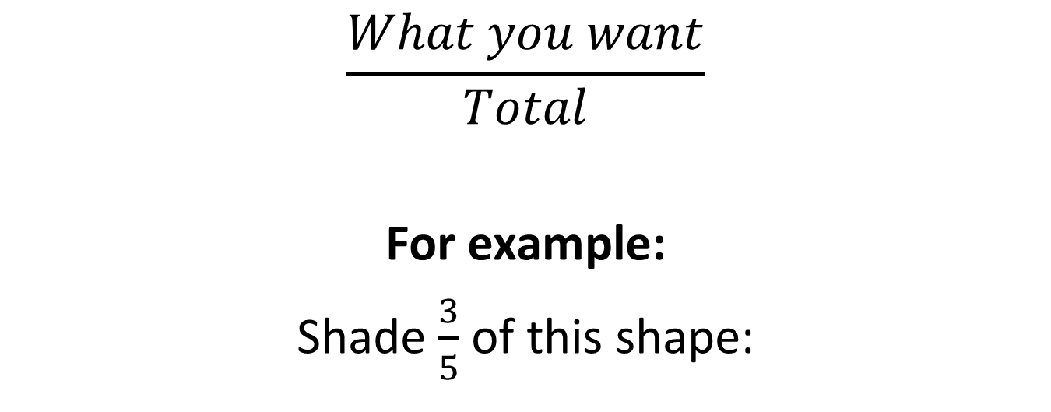
What is a fraction?
$$\frac{What you want}{Total}$$
For example:
Shade $\frac{3}{5}$ of this shape:
What you want (shaded) = 3
Total = 5

Slide 4
SUCCESS CRITERIA – WHERE ARE WE NOW?
Level | Learning outcomes: | R | A | G
F1 | I can simplify fractions to their lowest terms.
E2 | I can order fractions by using equivalence.
E2 | I can use fraction, decimal and percentage equivalents.
E3 | I can use the four rules with decimals.
E3 | I can find a fraction and percentage of a number.
D2 | I can add and subtract fractions.
C3 | I can multiply and divide fractions.
C1 | I can add, subtract, multiply and divide mixed numbers.
C3 | I can increase or decrease a value by a given percentage using a multiplier.
C3 | I can find the percentage change.
C1 | I can perform repeated percentage changes using just one calculation.
B2 | I can write fractions as recurring decimals and vice versa.

Slide 5

Simplifying fractions
Grade F

Slide 6
SUCCESS CRITERIA – WHERE ARE WE NOW?
Level | Learning outcomes: | R | A | G
F1 | I can simplify fractions to their lowest terms.
E2 | I can order fractions by using equivalence.
E2 | I can use fraction, decimal and percentage equivalents.
E3 | I can use the four rules with decimals.
E3 | I can find a fraction and percentage of a number.
D2 | I can add and subtract fractions.
C3 | I can multiply and divide fractions.
C1 | I can add, subtract, multiply and divide mixed numbers.
C3 | I can increase or decrease a value by a given percentage using a multiplier.
C3 | I can find the percentage change.
C1 | I can perform repeated percentage changes using just one calculation.
B2 | I can write fractions as recurring decimals and vice versa.

Slide 7
How to simplify a fraction:
Find a times table that both top (numerator) and bottom (denominator) are in.
Divide both top and bottom by that number.
Keep going until the only times table that goes into both is the 1 times table.

Slide 8
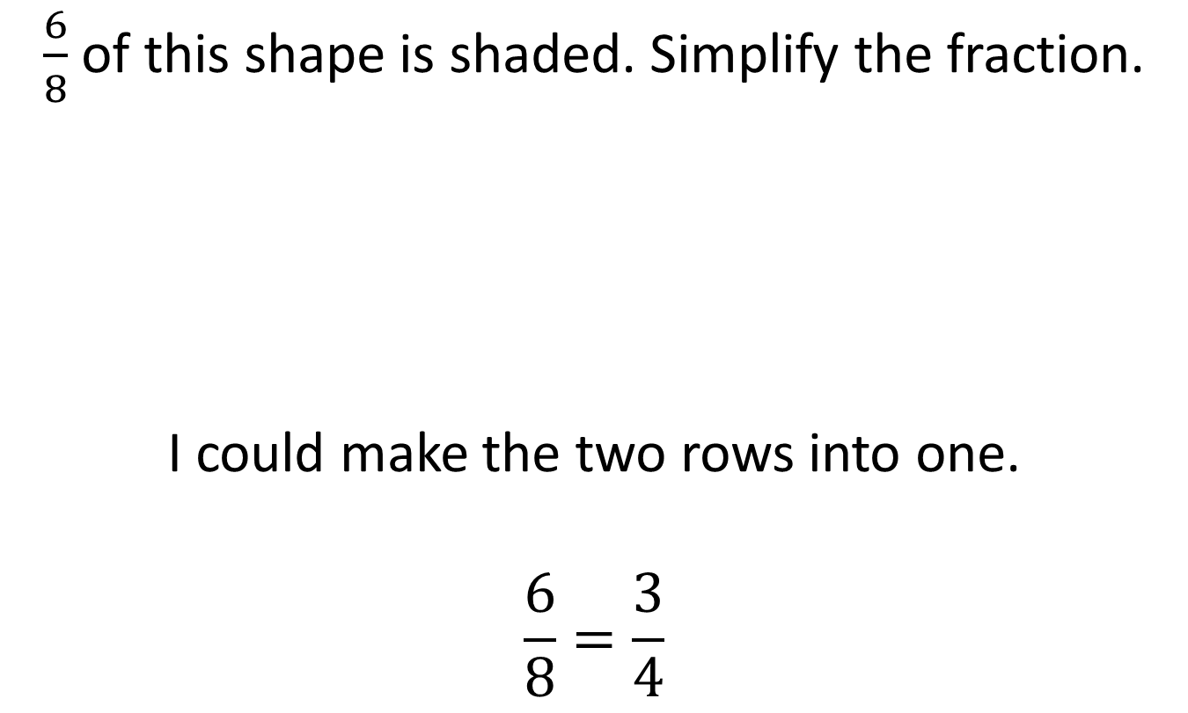
Simplifying using pictures
$\frac{6}{8}$ of this shape is shaded. Simplify the fraction.
I could make the two rows into one.
$$\frac{6}{8}=\frac{3}{4}$$

Slide 9

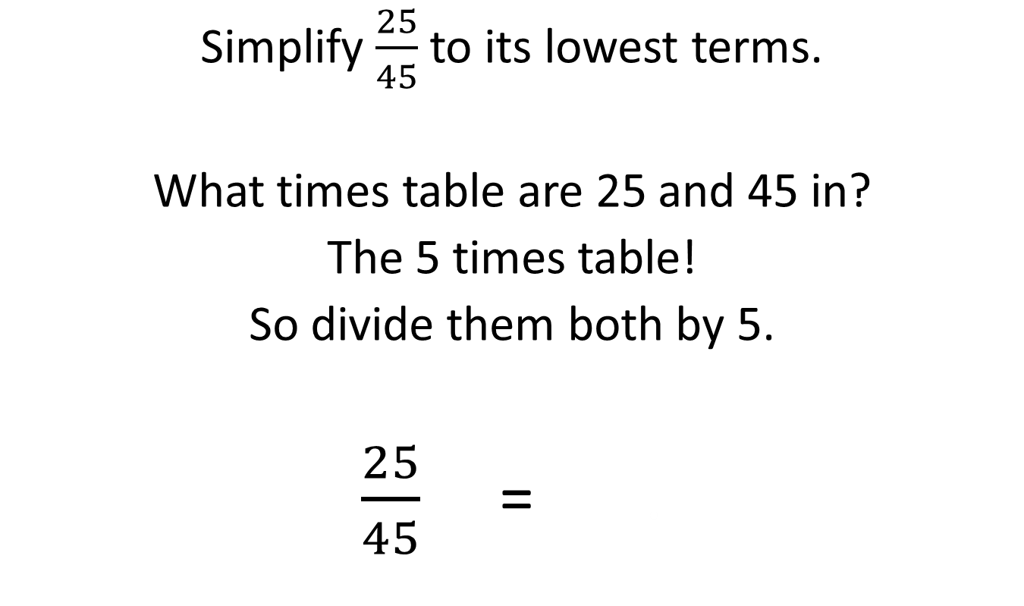
Without a picture, an example:
Simplify $\frac{25}{45}$ to its lowest terms.
What times table are 25 and 45 in?
The 5 times table!
So divide them both by 5.
$\frac{25}{45}$ = .
÷5
$$\frac{5}{9}$$
÷5

Slide 10

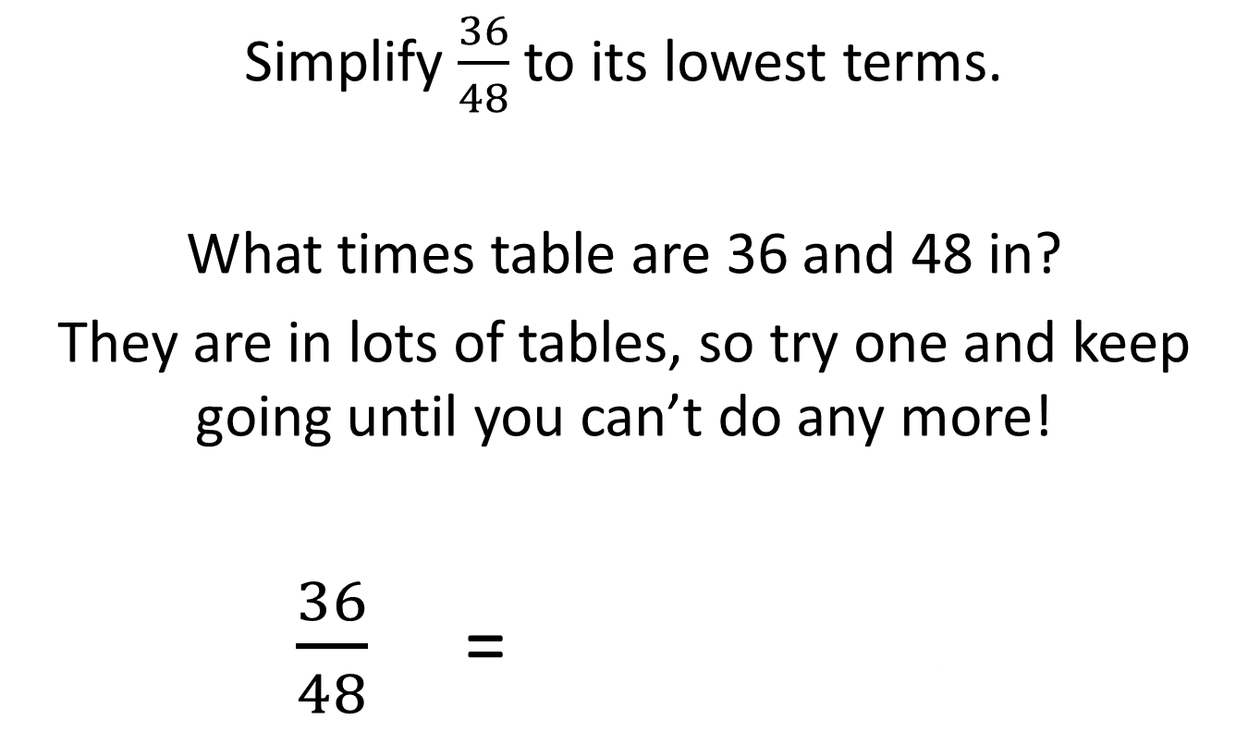

Another example:
Simplify $\frac{36}{48}$ to its lowest terms.
What times table are 36 and 48 in?
They are in lots of tables, so try one and keep going until you can’t do any more!
$\frac{36}{48}$ = .
÷4
÷3
$$\frac{9}{12}$$
=
$$\frac{3}{4}$$
÷4
÷3

Slide 11







Simplify these, giving your answers in their simplest form:
$\frac{24}{30}$
$\frac{35}{49}$
$\frac{28}{42}$
$\frac{16}{48}$
$\frac{18}{42}$
$$\frac{4}{5}$$
$$\frac{5}{7}$$
$$\frac{2}{3}$$
$$\frac{1}{3}$$
$$\frac{3}{7}$$

Slide 12
SUCCESS CRITERIA – WHERE ARE WE NOW?
Level | Learning outcomes: | R | A | G
F1 | I can simplify fractions to their lowest terms.
E2 | I can order fractions by using equivalence.
E2 | I can use fraction, decimal and percentage equivalents.
E3 | I can use the four rules with decimals.
E3 | I can find a fraction and percentage of a number.
D2 | I can add and subtract fractions.
C3 | I can multiply and divide fractions.
C1 | I can add, subtract, multiply and divide mixed numbers.
C3 | I can increase or decrease a value by a given percentage using a multiplier.
C3 | I can find the percentage change.
C1 | I can perform repeated percentage changes using just one calculation.
B2 | I can write fractions as recurring decimals and vice versa.

Slide 13

Using equivalent fractions
Grade E

Slide 14
SUCCESS CRITERIA – WHERE ARE WE NOW?
Level | Learning outcomes: | R | A | G
F1 | I can simplify fractions to their lowest terms.
E2 | I can order fractions by using equivalence.
E2 | I can use fraction, decimal and percentage equivalents.
E3 | I can use the four rules with decimals.
E3 | I can find a fraction and percentage of a number.
D2 | I can add and subtract fractions.
C3 | I can multiply and divide fractions.
C1 | I can add, subtract, multiply and divide mixed numbers.
C3 | I can increase or decrease a value by a given percentage using a multiplier.
C3 | I can find the percentage change.
C1 | I can perform repeated percentage changes using just one calculation.
B2 | I can write fractions as recurring decimals and vice versa.

Slide 15
When would you use equivalent fractions?
The main use for them at this stage is to put fractions in order.
If all the fractions you are ordering are over different denominators, it’s difficult.
If they are all over the same denominator, it’s easy because you just compare the numerators.

Slide 16

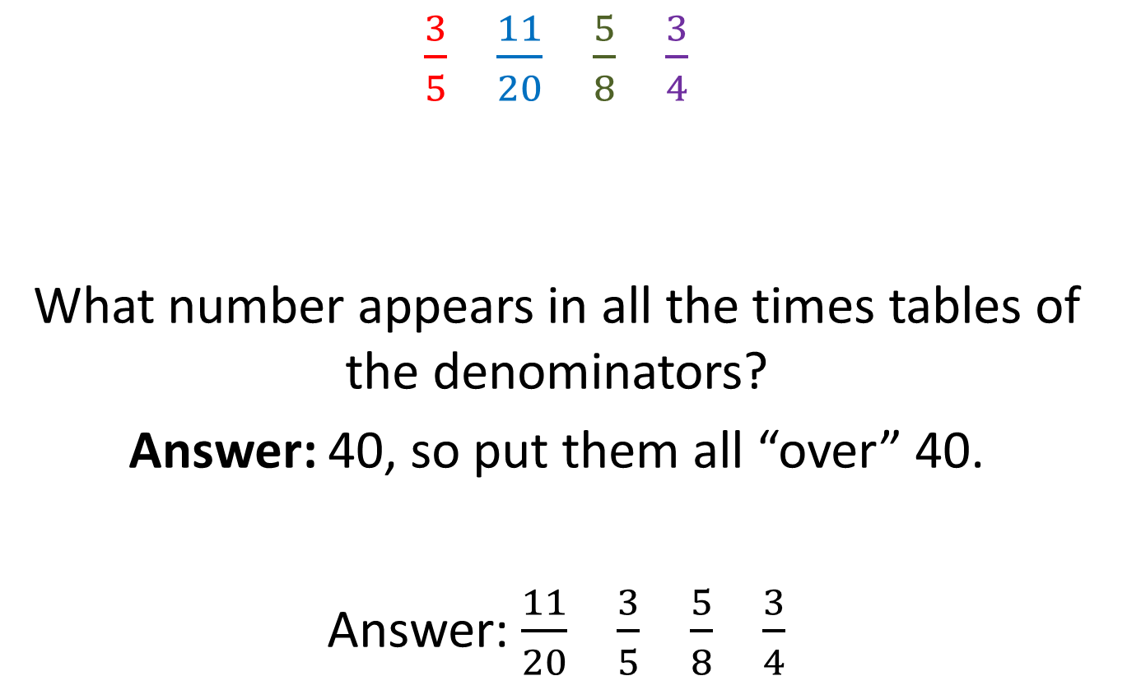



Put these fractions in ascending order:
$\frac{3}{5}$ $\frac{11}{20}$ $\frac{5}{8}$ $\frac{3}{4}$
What number appears in all the times tables of the denominators?
Answer: 40, so put them all “over” 40.
Answer: $\frac{11}{20}$ $\frac{3}{5}$ $\frac{5}{8}$ $\frac{3}{4}$
24
22
25
30
$$\frac{?}{40}$$
$$\frac{?}{40}$$
$$\frac{?}{40}$$
$$\frac{?}{40}$$

Slide 17
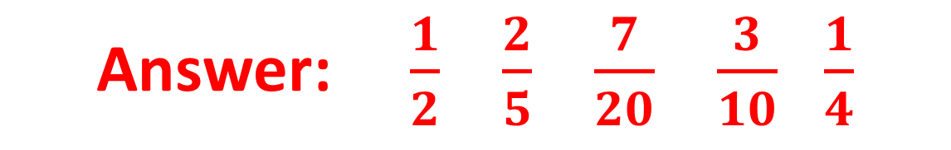

Put these fractions in descending order:
$\frac{1}{4}$ $\frac{2}{5}$ $\frac{3}{10}$ $\frac{1}{2}$ $\frac{7}{20}$
Answer: $\frac{1}{2}$ $\frac{2}{5}$ $\frac{7}{20}$ $\frac{3}{10}$ $\frac{1}{4}$

Slide 18
SUCCESS CRITERIA – WHERE ARE WE NOW?
Level | Learning outcomes: | R | A | G
F1 | I can simplify fractions to their lowest terms.
E2 | I can order fractions by using equivalence.
E2 | I can use fraction, decimal and percentage equivalents.
E3 | I can use the four rules with decimals.
E3 | I can find a fraction and percentage of a number.
D2 | I can add and subtract fractions.
C3 | I can multiply and divide fractions.
C1 | I can add, subtract, multiply and divide mixed numbers.
C3 | I can increase or decrease a value by a given percentage using a multiplier.
C3 | I can find the percentage change.
C1 | I can perform repeated percentage changes using just one calculation.
B2 | I can write fractions as recurring decimals and vice versa.

Slide 19

Equivalent fractions, decimals and percentages
Grade E

Slide 20
SUCCESS CRITERIA – WHERE ARE WE NOW?
Level | Learning outcomes: | R | A | G
F1 | I can simplify fractions to their lowest terms.
E2 | I can order fractions by using equivalence.
E2 | I can use fraction, decimal and percentage equivalents.
E3 | I can use the four rules with decimals.
E3 | I can find a fraction and percentage of a number.
D2 | I can add and subtract fractions.
C3 | I can multiply and divide fractions.
C1 | I can add, subtract, multiply and divide mixed numbers.
C3 | I can increase or decrease a value by a given percentage using a multiplier.
C3 | I can find the percentage change.
C1 | I can perform repeated percentage changes using just one calculation.
B2 | I can write fractions as recurring decimals and vice versa.

Slide 21
The cycle!
Put over 100 and simplify
Fraction
Decimal
Percentage
Top ÷ Bottom
× 100

Slide 22
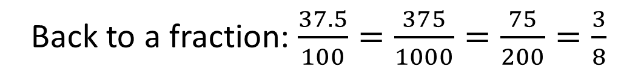

How does the cycle work?
Put over 100 and simplify
Fraction
Decimal
Percentage
× 100
Top ÷ Bottom
Write $\frac{3}{8}$ as a percentage and decimal.
As a decimal: 3 ÷ 8 = 0.375
As a percentage: 0.375 × 100 = 37.5%
Back to a fraction: $\frac{37.5}{100}=\frac{375}{1000}=\frac{75}{200}=\frac{3}{8}$

Slide 23
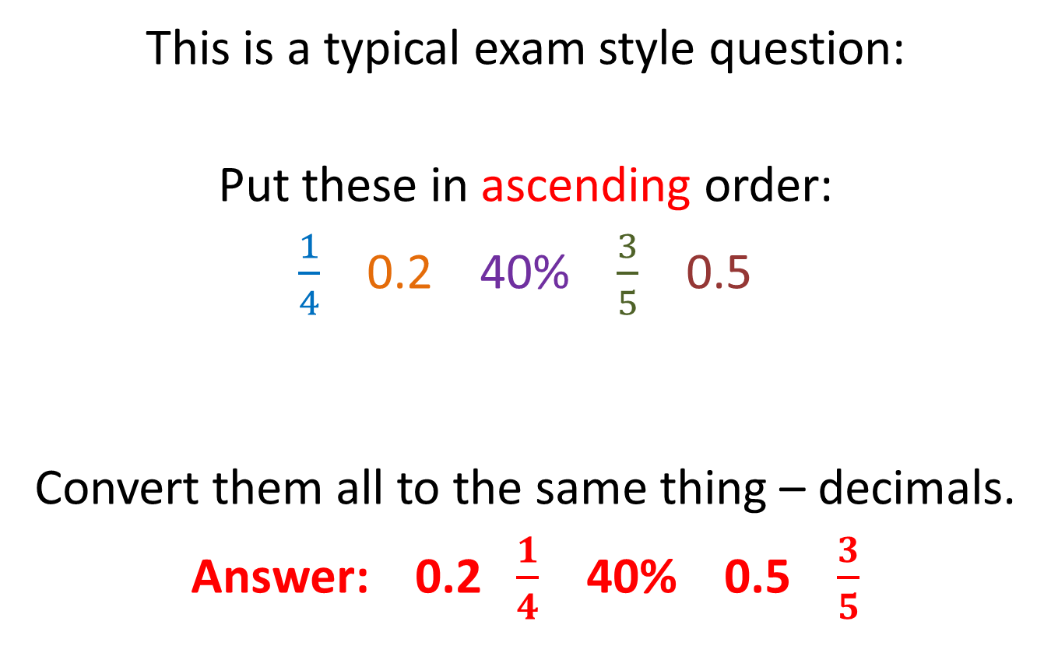
How it’s used in exams:
This is a typical exam style question:
Put these in ascending order:
$\frac{1}{4}$ 0.2 40% $\frac{3}{5}$ 0.5
Convert them all to the same thing – decimals.
Answer: 0.2 $\frac{1}{4}$ 40% 0.5 $\frac{3}{5}$
Ascending mean “from smallest to biggest
0.25
0.2
0.4
0.6
0.5

Slide 24

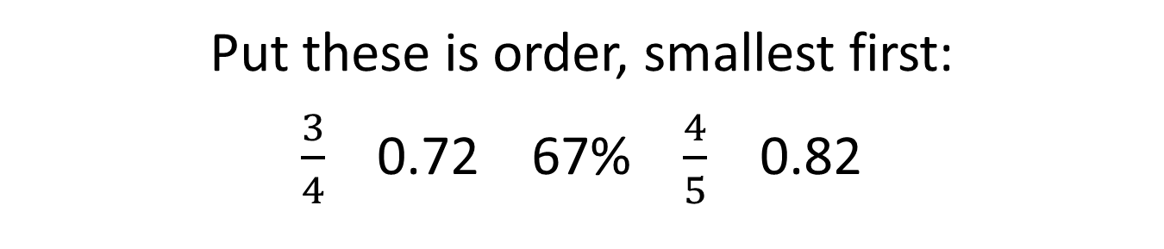
Have a go at this question:
Put these is order, smallest first:
$\frac{3}{4}$ 0.72 67% $\frac{4}{5}$ 0.82
Answer: 67% 0.72 $\frac{3}{4}$ $\frac{4}{5}$ 0.82

Slide 25
SUCCESS CRITERIA – WHERE ARE WE NOW?
Level | Learning outcomes: | R | A | G
F1 | I can simplify fractions to their lowest terms.
E2 | I can order fractions by using equivalence.
E2 | I can use fraction, decimal and percentage equivalents.
E3 | I can use the four rules with decimals.
E3 | I can find a fraction and percentage of a number.
D2 | I can add and subtract fractions.
C3 | I can multiply and divide fractions.
C1 | I can add, subtract, multiply and divide mixed numbers.
C3 | I can increase or decrease a value by a given percentage using a multiplier.
C3 | I can find the percentage change.
C1 | I can perform repeated percentage changes using just one calculation.
B2 | I can write fractions as recurring decimals and vice versa.

Slide 26

The four rules and decimals
Grade E

Slide 27
SUCCESS CRITERIA – WHERE ARE WE NOW?
Level | Learning outcomes: | R | A | G
F1 | I can simplify fractions to their lowest terms.
E2 | I can order fractions by using equivalence.
E2 | I can use fraction, decimal and percentage equivalents.
E3 | I can use the four rules with decimals.
E3 | I can find a fraction and percentage of a number.
D2 | I can add and subtract fractions.
C3 | I can multiply and divide fractions.
C1 | I can add, subtract, multiply and divide mixed numbers.
C3 | I can increase or decrease a value by a given percentage using a multiplier.
C3 | I can find the percentage change.
C1 | I can perform repeated percentage changes using just one calculation.
B2 | I can write fractions as recurring decimals and vice versa.

Slide 28
Adding and Subtracting Decimals
The key to this is to make sure that the decimal points are all in a column before you start.
So 1.45 + 12.2 would look like this:
 | 1 | . | 4 | 5
1 | 2 | . | 2 |  | +
1
3
.
6
5
Decimal points in a column

Slide 29
Have a go at these:
= 19.65
16.4 + 3.25
22.74 + 1.89
14.76 – 2.23
8.23 – 3.57
= 24.83
= 12.53
= 4.66

Slide 30
Multiplying “easy” decimals:
Count how many decimal places are in the question.
Forget the decimal points and multiply the numbers as if they were whole.
The answer needs the same number of decimal places as in the question.

Slide 31
An example:
Calculate 0.6 × 0.4
There are 2 decimal places in the question.
Multiply: 6 × 4 = 24
There should be 2 decimal places in the answer:
0.24
2 decimal places
2 decimal places

Slide 32
Have a go at these:
= 0.12
0.3 × 0.4
0.5 × 0.8
0.2 × 0.3
1.2 × 0.7
0.06 × 0.3
0.04 × 0.006
= 0.4
= 0.06
= 0.84
= 0.018
= 0.00024

Slide 33
Multiplying decimals
Possibly the best way of doing this with more difficult decimals is using the “Chinese” method.
You use a grid, forgetting about the decimal points before replacing them at the end.

Slide 34
An example of multiplying decimals:
Calculate 3.62 × 7.4.
Answer: 26.788
Work out where the decimal point should be
3
.
6
2
2
4
1
7
2
1
2
4
.
1
2
0
4
6
2
4
8
.
7
8
8
Add up along the diagonals
Read around the bottom

Slide 35
Another example:
Calculate 14.3 × 9.2.
Answer: 131.56
Work out where the decimal point should be
1
4
.
3
0
3
2
9
1
9
6
7
.
0
0
0
2
3
2
8
6
1
5
6
.
Add up along the diagonals
Read around the bottom

Slide 36
Try these:
= 90.22
34.7 × 2.6
9.42 × 1.7
341 × 0.46
= 16.014
= 156.86

Slide 37
Dividing Decimals
Dividing by a decimal is difficult!
But we can keep multiplying by 10 until the divisor (the number you are dividing by) becomes a whole number.
This makes it much easier!

Slide 38
How do we do that?
If I show you a simple example it should become clear.
20 ÷ 5 = 4
But…
200 ÷ 50 = 4
2000 ÷ 500 = 4
Etc.
That’s easy!
Multiply the question by 10
Multiply the question by 100
We keep getting the answer 4

Slide 39
Dividing by a decimal:
Calculate 24 ÷ 0.06
Multiply by 10:
240 ÷ 0.6
Multiply by 10 again:
2400 ÷ 6
The divisor is now a whole number!
2400 ÷ 6 = 400

Slide 40
Have a go at these:
= 60
18 ÷ 0.3
3 ÷ 0.06
0.14 ÷ 0.7
320 ÷ 0.008
= 50
= 0.2
= 40,000

Slide 41
SUCCESS CRITERIA – WHERE ARE WE NOW?
Level | Learning outcomes: | R | A | G
F1 | I can simplify fractions to their lowest terms.
E2 | I can order fractions by using equivalence.
E2 | I can use fraction, decimal and percentage equivalents.
E3 | I can use the four rules with decimals.
E3 | I can find a fraction and percentage of a number.
D2 | I can add and subtract fractions.
C3 | I can multiply and divide fractions.
C1 | I can add, subtract, multiply and divide mixed numbers.
C3 | I can increase or decrease a value by a given percentage using a multiplier.
C3 | I can find the percentage change.
C1 | I can perform repeated percentage changes using just one calculation.
B2 | I can write fractions as recurring decimals and vice versa.

Slide 42

Fraction and percentage of an amount
Grade E

Slide 43
SUCCESS CRITERIA – WHERE ARE WE NOW?
Level | Learning outcomes: | R | A | G
F1 | I can simplify fractions to their lowest terms.
E2 | I can order fractions by using equivalence.
E2 | I can use fraction, decimal and percentage equivalents.
E3 | I can use the four rules with decimals.
E3 | I can find a fraction and percentage of a number.
D2 | I can add and subtract fractions.
C3 | I can multiply and divide fractions.
C1 | I can add, subtract, multiply and divide mixed numbers.
C3 | I can increase or decrease a value by a given percentage using a multiplier.
C3 | I can find the percentage change.
C1 | I can perform repeated percentage changes using just one calculation.
B2 | I can write fractions as recurring decimals and vice versa.

Slide 44
Fraction of an amount
Remember this:
Divide by the bottom
Multiply by the top
If you do each calculation that way around you will be working with smaller numbers, but it does work either way.

Slide 45
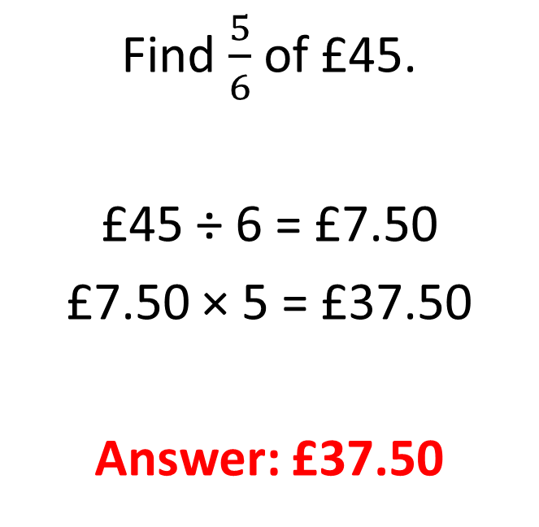
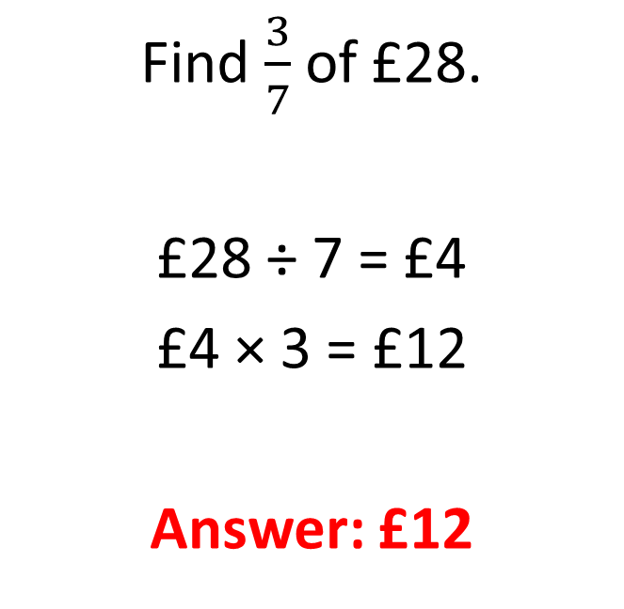
Some fraction of a number examples:
Example 1
Example 2
Find $\frac{3}{7}$ of £28.
£28 ÷ 7 = £4
£4 × 3 = £12
Answer: £12
Find $\frac{5}{6}$ of £45.
£45 ÷ 6 = £7.50
£7.50 × 5 = £37.50
Answer: £37.50

Slide 46

Have a go at these:
Find:
$\frac{1}{6}$ of £30.
$\frac{3}{4}$ of £24.
$\frac{2}{5}$ of £45.
$\frac{5}{7}$ of £140.
$\frac{3}{8}$ of £36.
= £5
= £5
= £18
= £100
= £13.50

Slide 47
Percentage of an amount
A percentage is a fraction with a denominator of 100.
Divide by the 100
Multiply by the percentage you want

Slide 48
Some percentage of a number examples:
Example 1
Example 2
Find 30% of £150.
£150 ÷ 100 = £1.50
£1.50 × 30 = £45
Answer: £45
Find 15% of £23.
£23 ÷ 100 = £0.23
£0.23 × 15 = £3.45
Answer: £3.45
Could you do this without a calculator?

Slide 49
Have a go at these:
Find:
40% of £30.
25% of £24.
80% of £45.
62% of £140.
7% of £36.
= £12
= £6
= £36
= £86.80
= £2.52

Slide 50
SUCCESS CRITERIA – WHERE ARE WE NOW?
Level | Learning outcomes: | R | A | G
F1 | I can simplify fractions to their lowest terms.
E2 | I can order fractions by using equivalence.
E2 | I can use fraction, decimal and percentage equivalents.
E3 | I can use the four rules with decimals.
E3 | I can find a fraction and percentage of a number.
D2 | I can add and subtract fractions.
C3 | I can multiply and divide fractions.
C1 | I can add, subtract, multiply and divide mixed numbers.
C3 | I can increase or decrease a value by a given percentage using a multiplier.
C3 | I can find the percentage change.
C1 | I can perform repeated percentage changes using just one calculation.
B2 | I can write fractions as recurring decimals and vice versa.

Slide 51

Adding and subtracting fractions
Grade D

Slide 52
SUCCESS CRITERIA – WHERE ARE WE NOW?
Level | Learning outcomes: | R | A | G
F1 | I can simplify fractions to their lowest terms.
E2 | I can order fractions by using equivalence.
E2 | I can use fraction, decimal and percentage equivalents.
E3 | I can use the four rules with decimals.
E3 | I can find a fraction and percentage of a number.
D2 | I can add and subtract fractions.
C3 | I can multiply and divide fractions.
C1 | I can add, subtract, multiply and divide mixed numbers.
C3 | I can increase or decrease a value by a given percentage using a multiplier.
C3 | I can find the percentage change.
C1 | I can perform repeated percentage changes using just one calculation.
B2 | I can write fractions as recurring decimals and vice versa.

Slide 53
Important!
You may have heard the phrase “common denominator” when people talk about adding and subtracting fractions.
What that means is that you can’t add or subtract unless the bottom numbers of all the fractions are the same.

Slide 54
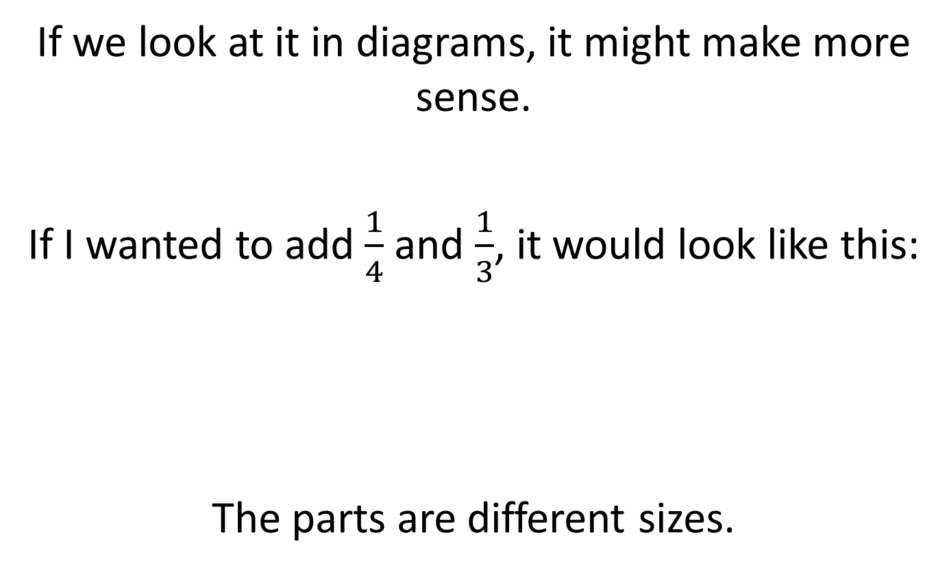
Common Denominators – Eh?
If we look at it in diagrams, it might make more sense.
If I wanted to add $\frac{1}{4}$ and $\frac{1}{3}$, it would look like this:
The parts are different sizes.

Slide 55
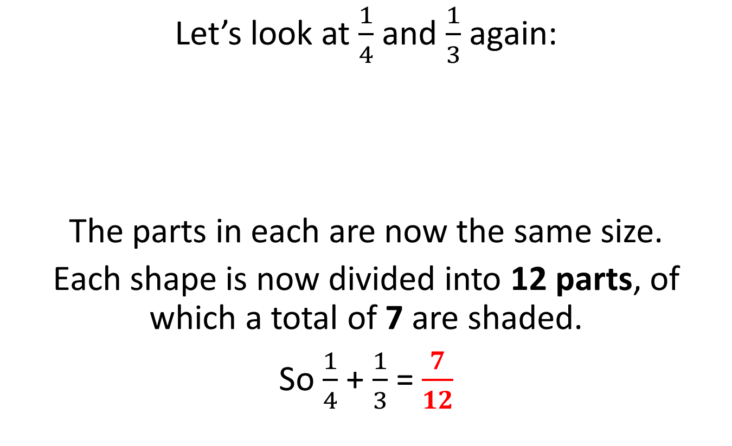
How common denominators work:
Let’s look at $\frac{1}{4}$ and $\frac{1}{3}$ again:
The parts in each are now the same size.
Each shape is now divided into 12 parts, of which a total of 7 are shaded.
So $\frac{1}{4}$ + $\frac{1}{3}$ = $\frac{7}{12}$

Slide 56

Another example, without diagrams:
Calculate $\frac{3}{5}−\frac{1}{3}$.
Common denominator: $5×3=15$
$$\frac{3}{5} − \frac{1}{3}$$
$$\frac{9}{15} − \frac{5}{15} = \frac{4}{15}$$
×3
×5

Slide 57
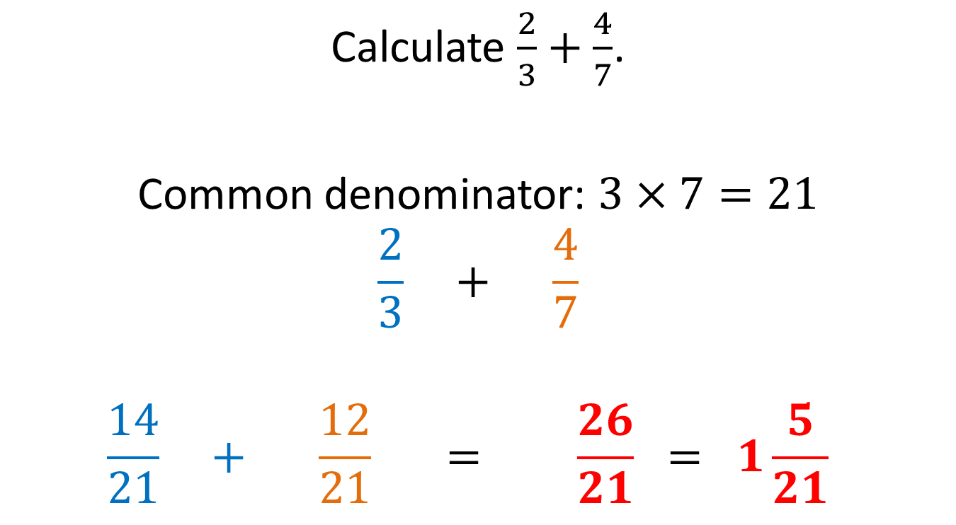
Yet another example, without diagrams:
Calculate $\frac{2}{3}+\frac{4}{7}$.
Common denominator: $3×7=21$
$$\frac{2}{3} + \frac{4}{7}$$
$$\frac{14}{21} + \frac{12}{21} = \frac{26}{21} = 1\frac{5}{21}$$
×7
×3

Slide 58
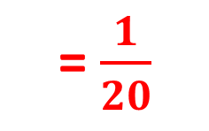
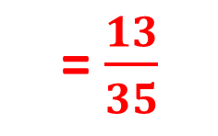

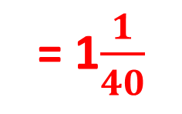
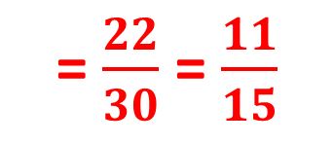
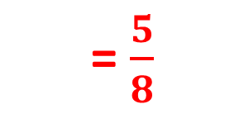
Have a go at these:
= $\frac{1}{20}$
$\frac{4}{5}−\frac{3}{4}$
$\frac{3}{8}+\frac{1}{4}$
$\frac{9}{10}−\frac{1}{6}$
$\frac{5}{8}+\frac{2}{5}$
$\frac{4}{5}−\frac{3}{7}$
= $\frac{5}{8}$
= $\frac{22}{30}$ = $\frac{11}{15}$
= 1$\frac{1}{40}$
= $\frac{13}{35}$

Slide 59
SUCCESS CRITERIA – WHERE ARE WE NOW?
Level | Learning outcomes: | R | A | G
F1 | I can simplify fractions to their lowest terms.
E2 | I can order fractions by using equivalence.
E2 | I can use fraction, decimal and percentage equivalents.
E3 | I can use the four rules with decimals.
E3 | I can find a fraction and percentage of a number.
D2 | I can add and subtract fractions.
C3 | I can multiply and divide fractions.
C1 | I can add, subtract, multiply and divide mixed numbers.
C3 | I can increase or decrease a value by a given percentage using a multiplier.
C3 | I can find the percentage change.
C1 | I can perform repeated percentage changes using just one calculation.
B2 | I can write fractions as recurring decimals and vice versa.

Slide 60

Multiplying and dividing fractions
Grade C

Slide 61
SUCCESS CRITERIA – WHERE ARE WE NOW?
Level | Learning outcomes: | R | A | G
F1 | I can simplify fractions to their lowest terms.
E2 | I can order fractions by using equivalence.
E2 | I can use fraction, decimal and percentage equivalents.
E3 | I can use the four rules with decimals.
E3 | I can find a fraction and percentage of a number.
D2 | I can add and subtract fractions.
C3 | I can multiply and divide fractions.
C1 | I can add, subtract, multiply and divide mixed numbers.
C3 | I can increase or decrease a value by a given percentage using a multiplier.
C3 | I can find the percentage change.
C1 | I can perform repeated percentage changes using just one calculation.
B2 | I can write fractions as recurring decimals and vice versa.

Slide 62
Multiplying fractions
This is really easy!
Multiply the top.
Multiply the bottom.
That’s really it!

Slide 63
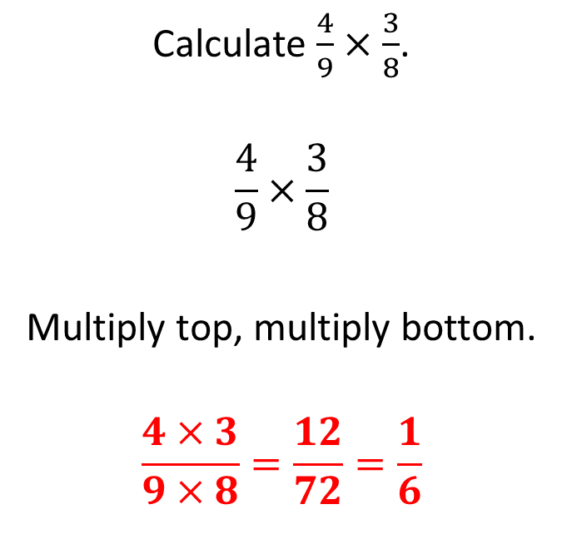
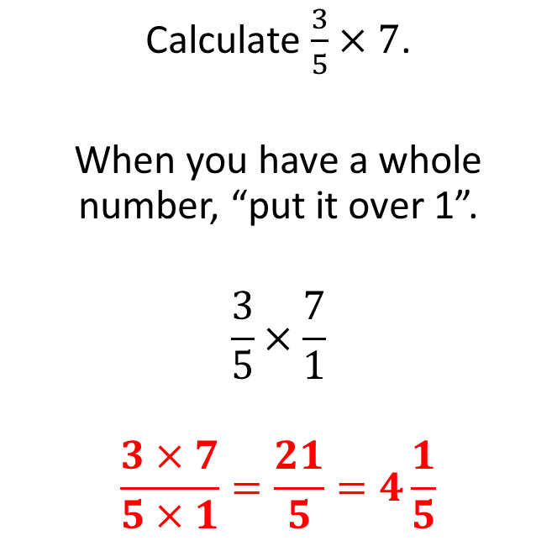
Two examples
Example 1
Example 2
Calculate $\frac{3}{5}×7$.
When you have a whole number, “put it over 1”.
$$\frac{3}{5}×\frac{7}{1}$$
$$\frac{3×7}{5×1}=\frac{21}{5}=4\frac{1}{5}$$
Calculate $\frac{4}{9}×\frac{3}{8}$.
$$\frac{4}{9}×\frac{3}{8}$$
Multiply top, multiply bottom.
$$\frac{4×3}{9×8}=\frac{12}{72}=\frac{1}{6}$$
Could you have simplified the second example before multiplying?

Slide 64
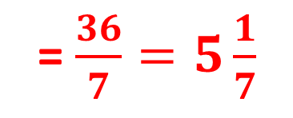
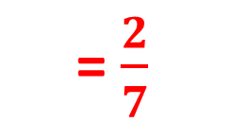

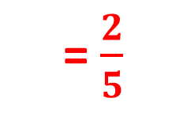
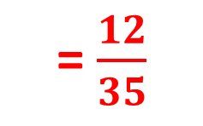
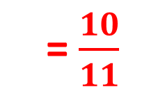
Try these:
= $\frac{36}{7}=5\frac{1}{7}$
$\frac{4}{7}×9$
$5×\frac{2}{11}$
$\frac{4}{5}×\frac{3}{7}$
$\frac{8}{15}×\frac{3}{4}$
$\frac{7}{19}×\frac{38}{49}$
= $\frac{10}{11}$
= $\frac{12}{35}$
= $\frac{2}{5}$
= $\frac{2}{7}$

Slide 65
Dividing fractions
This is as easy as multiplying!
First you turn the right hand fraction over.
Then multiply.

Slide 66
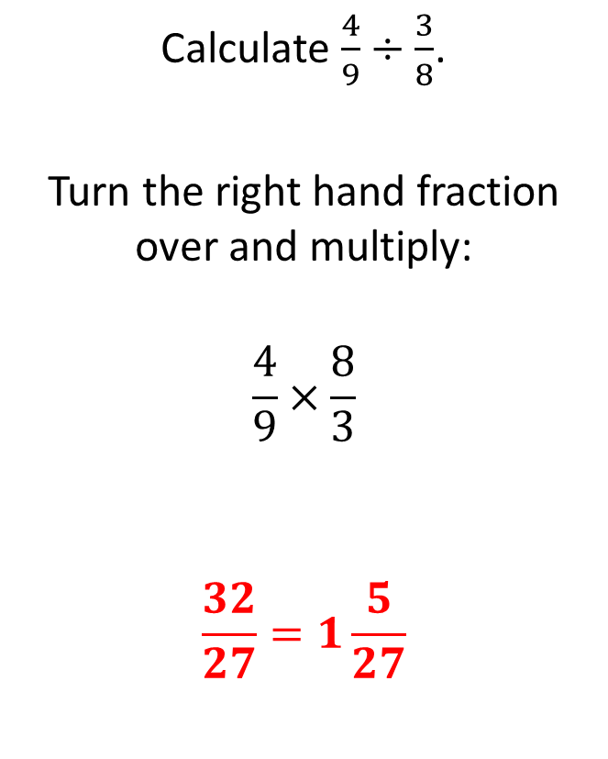
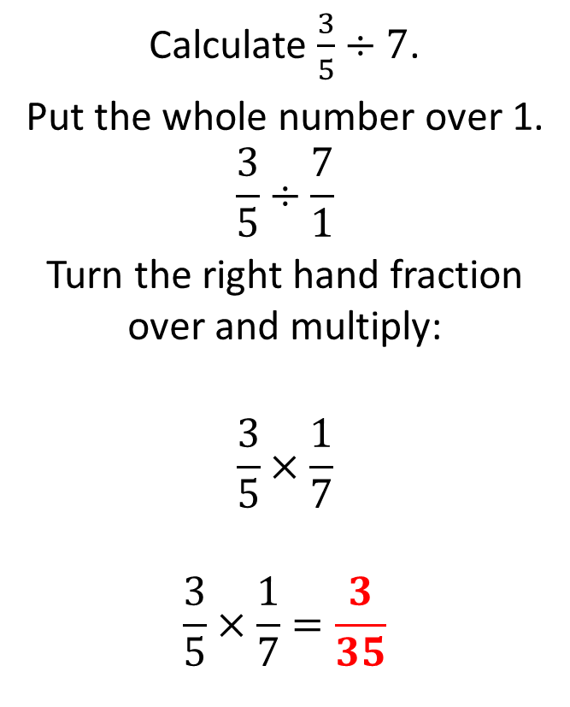
Two examples
Example 1
Example 2
Calculate $\frac{3}{5}÷7$.
Put the whole number over 1.
$$\frac{3}{5}÷\frac{7}{1}$$
Turn the right hand fraction over and multiply:
$$\frac{3}{5}×\frac{1}{7}$$
$$\frac{3}{5}×\frac{1}{7}=\frac{3}{35}$$
Calculate $\frac{4}{9}÷\frac{3}{8}$.
Turn the right hand fraction over and multiply:
$$\frac{4}{9}×\frac{8}{3}$$
$$\frac{32}{27}=1\frac{5}{27}$$

Slide 67
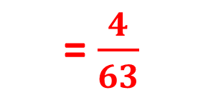


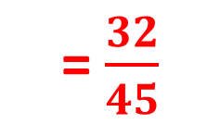
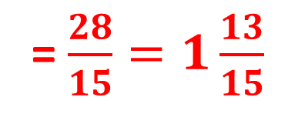

Have a go at these:
= $\frac{4}{63}$
$\frac{4}{7}÷9$
$5÷\frac{2}{11}$
$\frac{4}{5}÷\frac{3}{7}$
$\frac{8}{15}÷\frac{3}{4}$
$\frac{7}{8}÷\frac{21}{32}$
= $\frac{55}{2}=27\frac{1}{2}$
= $\frac{28}{15}=1\frac{13}{15}$
= $\frac{32}{45}$
= $\frac{4}{3}=1\frac{1}{3}$

Slide 68
SUCCESS CRITERIA – WHERE ARE WE NOW?
Level | Learning outcomes: | R | A | G
F1 | I can simplify fractions to their lowest terms.
E2 | I can order fractions by using equivalence.
E2 | I can use fraction, decimal and percentage equivalents.
E3 | I can use the four rules with decimals.
E3 | I can find a fraction and percentage of a number.
D2 | I can add and subtract fractions.
C3 | I can multiply and divide fractions.
C1 | I can add, subtract, multiply and divide mixed numbers.
C3 | I can increase or decrease a value by a given percentage using a multiplier.
C3 | I can find the percentage change.
C1 | I can perform repeated percentage changes using just one calculation.
B2 | I can write fractions as recurring decimals and vice versa.

Slide 69

The four rules with mixed numbers
Grade C

Slide 70
SUCCESS CRITERIA – WHERE ARE WE NOW?
Level | Learning outcomes: | R | A | G
F1 | I can simplify fractions to their lowest terms.
E2 | I can order fractions by using equivalence.
E2 | I can use fraction, decimal and percentage equivalents.
E3 | I can use the four rules with decimals.
E3 | I can find a fraction and percentage of a number.
D2 | I can add and subtract fractions.
C3 | I can multiply and divide fractions.
C1 | I can add, subtract, multiply and divide mixed numbers.
C3 | I can increase or decrease a value by a given percentage using a multiplier.
C3 | I can find the percentage change.
C1 | I can perform repeated percentage changes using just one calculation.
B2 | I can write fractions as recurring decimals and vice versa.

Slide 71

What are mixed numbers?
They are whole numbers and fractions.
Eg. $2\frac{1}{3}$ is a mixed number.
It is easier to convert mixed numbers to improper or top-heavy fractions – you must convert in order to multiply and divide.
Eg. $2\frac{1}{3}=\frac{2×3+1}{3}=\frac{7}{3}$
Then you add, subtract, multiply and divide as you have done before.

Slide 72


Adding and subtracting
Example 1
Example 2
Calculate $2\frac{3}{4}+1\frac{1}{3}$.
Convert to improper:
$$\frac{11}{4}+\frac{4}{3}$$
Common denominator:
$$\frac{33}{12}+\frac{16}{12}$$
Add up:
$$\frac{49}{12}=4\frac{1}{12}$$
Calculate $2\frac{3}{5}−1\frac{6}{7}$.
Convert to improper:
$$\frac{13}{5}−\frac{13}{7}$$
Common denominator:
$$\frac{91}{35}−\frac{65}{35}$$
Subtract:
$$\frac{26}{35}$$

Slide 73






Have a go at these:
= $3\frac{3}{4}$
$2\frac{1}{4}+1\frac{1}{2}$
$2\frac{3}{4}−1\frac{2}{5}$
$5\frac{2}{3}+1\frac{3}{5}$
$3\frac{1}{4}−1\frac{3}{7}$
$2\frac{6}{11}+3\frac{4}{7}$
= $1\frac{7}{20}$
= $7\frac{4}{15}$
= $1\frac{23}{28}$
= $6\frac{9}{77}$

Slide 74


Multiplying and dividing
Example 1
Example 2
Calculate $2\frac{3}{4}×1\frac{1}{3}$.
Convert to improper:
$$\frac{11}{4}×\frac{4}{3}$$
Multiply:
$$\frac{44}{12}=3\frac{8}{12}=3\frac{2}{3}$$
Calculate $2\frac{3}{4}÷1\frac{1}{3}$.
Convert to improper:
$$\frac{11}{4}÷\frac{4}{3}$$
Turn the right hand fraction:
$$\frac{11}{4}×\frac{3}{4}$$
Multiply:
$$\frac{33}{16}=2\frac{1}{16}$$
Could you have simplified before multiplying?

Slide 75






Have a go at these:
= $3\frac{3}{8}$
$2\frac{1}{4}×1\frac{1}{2}$
$2\frac{3}{4}÷1\frac{2}{5}$
$5\frac{2}{3}×1\frac{3}{5}$
$3\frac{1}{4}÷1\frac{3}{7}$
$2\frac{6}{11}÷3\frac{4}{7}$
= $1\frac{27}{28}$
= 9$\frac{1}{15}$
= 2$\frac{11}{40}$
= $\frac{196}{275}$

Slide 76
SUCCESS CRITERIA – WHERE ARE WE NOW?
Level | Learning outcomes: | R | A | G
F1 | I can simplify fractions to their lowest terms.
E2 | I can order fractions by using equivalence.
E2 | I can use fraction, decimal and percentage equivalents.
E3 | I can use the four rules with decimals.
E3 | I can find a fraction and percentage of a number.
D2 | I can add and subtract fractions.
C3 | I can multiply and divide fractions.
C1 | I can add, subtract, multiply and divide mixed numbers.
C3 | I can increase or decrease a value by a given percentage using a multiplier.
C3 | I can find the percentage change.
C1 | I can perform repeated percentage changes using just one calculation.
B2 | I can write fractions as recurring decimals and vice versa.

Slide 77

Calculating percentage change using a multiplier
Grade C

Slide 78
SUCCESS CRITERIA – WHERE ARE WE NOW?
Level | Learning outcomes: | R | A | G
F1 | I can simplify fractions to their lowest terms.
E2 | I can order fractions by using equivalence.
E2 | I can use fraction, decimal and percentage equivalents.
E3 | I can use the four rules with decimals.
E3 | I can find a fraction and percentage of a number.
D2 | I can add and subtract fractions.
C3 | I can multiply and divide fractions.
C1 | I can add, subtract, multiply and divide mixed numbers.
C3 | I can increase or decrease a value by a given percentage using a multiplier.
C3 | I can find the percentage change.
C1 | I can perform repeated percentage changes using just one calculation.
B2 | I can write fractions as recurring decimals and vice versa.

Slide 79
How we calculate percentage increase and decrease:
You could find the percentage and add or subtract it to the original amount.
Or you could find the “multiplier”.
An increase of 10% means that you have 110% of the original amount.
A decrease of 15% means that you have 85% of the original amount.

Slide 80
How do you use multipliers?
Example 1
Example 2
Increase £270 by 20%.
An increase of 20% means that I have 120% of the original amount.
120% as a multiplier is 1.2.
£270 × 1.2 = £324
Decrease £135 by 7%.
A decrease of 7% means that I have 93% of the original amount.
93% as a multiplier is 0.93.
£135 × 0.93 = £125.55

Slide 81
Some questions for you:
£299
Increase £230 by 30%.
Decrease £65 by 45%.
Increase £32 by 4%.
Decrease £768 by 17%.
Andy has been offered a pay rise. He is currently paid £7.80 per hour. He must choose between a rise of 20p per hour or an increase of 3%. Which should he choose?
£42.25
£33.28
£637.44
An increase of 3% would be £8.03 per hour.

Slide 82
Working backwards – finding the original amount
Whereas before we multiplied…
When finding an original amount, you always divide!
Original amount × multiplier = New amount
Original amount = New amount ÷ multiplier

Slide 83
Finding the original:
Example 1
Example 2
The population of a town has increased by 15% to 207,000 in the last 10 years. How many people lived in the town 10 years ago?
207,000 ÷ 1.15
180,000 people
A shirt was reduced in a sale by 20%. It was £71.20 in the sale. How much is the shirt normally?
£71.20 ÷ 0.8
£89

Slide 84
Find the original prices for these sale items:
£110
A pair of trousers reduced by 30% to £77.
A pair of shoes reduced by 25% to £63.75.
A jacket reduced by 42% to £84.10.
£85
£145
Find the original amounts following increases:
£520
A wage increased by 4% to £540.80 per week.
A population increased by 11% to 59,940.
A picture increased by 71% to 307.8cm.
54,000
180cm

Slide 85
SUCCESS CRITERIA – WHERE ARE WE NOW?
Level | Learning outcomes: | R | A | G
F1 | I can simplify fractions to their lowest terms.
E2 | I can order fractions by using equivalence.
E2 | I can use fraction, decimal and percentage equivalents.
E3 | I can use the four rules with decimals.
E3 | I can find a fraction and percentage of a number.
D2 | I can add and subtract fractions.
C3 | I can multiply and divide fractions.
C1 | I can add, subtract, multiply and divide mixed numbers.
C3 | I can increase or decrease a value by a given percentage using a multiplier.
C3 | I can find the percentage change.
C1 | I can perform repeated percentage changes using just one calculation.
B2 | I can write fractions as recurring decimals and vice versa.

Slide 86
Calculating percentage change
Grade C

Slide 87
SUCCESS CRITERIA – WHERE ARE WE NOW?
Level | Learning outcomes: | R | A | G
F1 | I can simplify fractions to their lowest terms.
E2 | I can order fractions by using equivalence.
E2 | I can use fraction, decimal and percentage equivalents.
E3 | I can use the four rules with decimals.
E3 | I can find a fraction and percentage of a number.
D2 | I can add and subtract fractions.
C3 | I can multiply and divide fractions.
C1 | I can add, subtract, multiply and divide mixed numbers.
C3 | I can increase or decrease a value by a given percentage using a multiplier.
C3 | I can find the percentage change.
C1 | I can perform repeated percentage changes using just one calculation.
B2 | I can write fractions as recurring decimals and vice versa.

Slide 88

How do we do that?
Remember this:
$$\frac{Difference}{Original amount}×100$$
This will work for all percentage change questions.

Slide 89


Two examples
Example 1
Example 2
The population of a town went up from 50,000 to 63,000 in 10 years. What percentage increase is this?
Change = £13,000
Original amount = £50,000
$$\frac{13000}{50000}×100=26\%$$
The value of a car went down from £12,500 to £9,000 in 1 year. What percentage decrease is this?
Change = £3,500
Original amount = £12,500
$$\frac{3500}{12500}×100=28\%$$

Slide 90
Have a go at this:
A property developer bought a house for £162,000. They spent £7000 renovating the house and then sold it for £185,000.
By what percentage had they increased the value of the property?
Answer: 9.88% (to 2 decimal places)

Slide 91
SUCCESS CRITERIA – WHERE ARE WE NOW?
Level | Learning outcomes: | R | A | G
F1 | I can simplify fractions to their lowest terms.
E2 | I can order fractions by using equivalence.
E2 | I can use fraction, decimal and percentage equivalents.
E3 | I can use the four rules with decimals.
E3 | I can find a fraction and percentage of a number.
D2 | I can add and subtract fractions.
C3 | I can multiply and divide fractions.
C1 | I can add, subtract, multiply and divide mixed numbers.
C3 | I can increase or decrease a value by a given percentage using a multiplier.
C3 | I can find the percentage change.
C1 | I can perform repeated percentage changes using just one calculation.
B2 | I can write fractions as recurring decimals and vice versa.

Slide 92

Repeated percentage change
Grade C

Slide 93
SUCCESS CRITERIA – WHERE ARE WE NOW?
Level | Learning outcomes: | R | A | G
F1 | I can simplify fractions to their lowest terms.
E2 | I can order fractions by using equivalence.
E2 | I can use fraction, decimal and percentage equivalents.
E3 | I can use the four rules with decimals.
E3 | I can find a fraction and percentage of a number.
D2 | I can add and subtract fractions.
C3 | I can multiply and divide fractions.
C1 | I can add, subtract, multiply and divide mixed numbers.
C3 | I can increase or decrease a value by a given percentage using a multiplier.
C3 | I can find the percentage change.
C1 | I can perform repeated percentage changes using just one calculation.
B2 | I can write fractions as recurring decimals and vice versa.

Slide 94
Repeated percentage change:
I invest £500 at a rate 4% per annum (means “per year”). How much would be in my account after 3 years?
500 × 1.04 = £520
520 × 1.04 = £540.80
540.80 × 1.04 = £562.43
There is a quicker way!
The calculation on the left is this:
£500 × 1.04 × 1.04 × 1.04
We can write that like this:
£500 × 1.04³ = £562.43

Slide 95


A couple of examples:
Example 1
Example 2
I invest £850 at a rate 2% per annum. How much would be in my account after 6 years?
£850 $×{1.02}^{6}$
Answer: £957.24
The value of a car reduces by 15% per year. If the car cost £18,000 when new, what would if be worth after 5 years?
£18,000 $×{0.85}^{5}$
Answer: £7986.70

Slide 96
Two questions for you:
Question 1
Question 2
The profit of a company has been projected to increase by 7% per year. This year’s profit was £230,000. How much profit do they expect to get in 4 years time?
Dave is reducing his credit card bill by 15% per month having built up a debt of £12,000. How many months will it take him to get his debt under £5000?
Answer: £301,483.08
Answer: 6 months

Slide 97
SUCCESS CRITERIA – WHERE ARE WE NOW?
Level | Learning outcomes: | R | A | G
F1 | I can simplify fractions to their lowest terms.
E2 | I can order fractions by using equivalence.
E2 | I can use fraction, decimal and percentage equivalents.
E3 | I can use the four rules with decimals.
E3 | I can find a fraction and percentage of a number.
D2 | I can add and subtract fractions.
C3 | I can multiply and divide fractions.
C1 | I can add, subtract, multiply and divide mixed numbers.
C3 | I can increase or decrease a value by a given percentage using a multiplier.
C3 | I can find the percentage change.
C1 | I can perform repeated percentage changes using just one calculation.
B2 | I can write fractions as recurring decimals and vice versa.

Slide 98

Writing fractions as recurring decimals and vice versa
Grade B

Slide 99
SUCCESS CRITERIA – WHERE ARE WE NOW?
Level | Learning outcomes: | R | A | G
F1 | I can simplify fractions to their lowest terms.
E2 | I can order fractions by using equivalence.
E2 | I can use fraction, decimal and percentage equivalents.
E3 | I can use the four rules with decimals.
E3 | I can find a fraction and percentage of a number.
D2 | I can add and subtract fractions.
C3 | I can multiply and divide fractions.
C1 | I can add, subtract, multiply and divide mixed numbers.
C3 | I can increase or decrease a value by a given percentage using a multiplier.
C3 | I can find the percentage change.
C1 | I can perform repeated percentage changes using just one calculation.
B2 | I can write fractions as recurring decimals and vice versa.

Slide 100

What is a recurring decimal?
A recurring decimal never ends and repeats a number or sequence of numbers.
We use the recurring notation like this:
$$0.\dot{6}=0.6666666666…$$
$$0.\dot{7}\dot{2}=0.7272727272…$$
$$0.3\dot{4}=0.3444444444444…$$
$$0.\dot{5}87\dot{2}=0.587258725872…$$

Slide 101


Fractions to recurring decimals:
As with all fractions, to convert a fraction to a decimal you just divide the top (numerator) by the bottom (denominator).
So, to convert $\frac{4}{9}$ to a decimal I would do this:
0
.
4
4
4
4
4
.
0
4
0
4
0
4
0
9
4
It will continue forever, so write it as $0.\dot{4}$

Slide 102





Convert these to decimals without a calculator using dot notation:
$\frac{2}{3}$
$\frac{1}{6}$
$\frac{4}{11}$
$\frac{2}{7}$
$$0.\dot{6}$$
$$0.1\dot{6}$$
$$0.\dot{3}\dot{6}$$
$$0.\dot{2}8571\dot{4}$$

Slide 103
Recurring decimals to fractions:
The key is to get rid of the recurring part.
We do this by multiplying by powers of 10 then subtracting.
The power of 10 we multiply by depends on how many numbers recur.

Slide 104


Converting from decimals to fractions
Example 1
Example 2
Write $0.\dot{2}$ as a fraction.
$$n=0.\dot{2}$$
$$10n=2.\dot{2}$$
The recurring parts are the same so subtract:
$$9n=2$$
$$n=\frac{2}{9}$$
Write $0.\dot{3}\dot{7}$ as a fraction.
$$n=0.\dot{3}\dot{7}$$
$$100n=37.\dot{3}\dot{7}$$
The recurring parts are the same so subtract:
$$99n=37$$
$$n=\frac{37}{99}$$
One number is recurring
Two numbers are recurring

Slide 105




Try converting these to fractions:
$$\frac{7}{9}$$
$0.\dot{7}$
$0.\dot{4}\dot{3}$
$0.\dot{6}4\dot{1}$
$$\frac{43}{99}$$
$$\frac{641}{999}$$

Slide 106


A little trickier, but the same process:
Example 1
Example 2
Write $0.4\dot{7}$ as a fraction.
$$n=0.4\dot{7}$$
$$10n=4.\dot{7}$$
$$100n=47.\dot{7}$$
The recurring parts are the same so subtract:
$$90n=43$$
$$n=\frac{43}{90}$$
Write $0.5\dot{2}4\dot{3}$ as a fraction.
$$n=0.5\dot{2}4\dot{3}$$
$$10n=5.\dot{2}4\dot{3}$$
$$10000n=5243.\dot{2}4\dot{3}$$
The recurring parts are the same so subtract:
$$9990n=5238$$
$$n=\frac{5238}{9990}$$
Don’t need this one anymore
Don’t need this one anymore

Slide 107




Have a go at converting these to fractions:
$$\frac{61}{90}$$
$0.6\dot{7}$
$0.5\dot{7}\dot{1}$
$0.59\dot{3}\dot{1}$
$$\frac{566}{990}=\frac{283}{495}$$
$$\frac{5872}{9900}=\frac{1468}{2475}$$

Slide 108
SUCCESS CRITERIA – WHERE ARE WE NOW?
Level | Learning outcomes: | R | A | G
F1 | I can simplify fractions to their lowest terms.
E2 | I can order fractions by using equivalence.
E2 | I can use fraction, decimal and percentage equivalents.
E3 | I can use the four rules with decimals.
E3 | I can find a fraction and percentage of a number.
D2 | I can add and subtract fractions.
C3 | I can multiply and divide fractions.
C1 | I can add, subtract, multiply and divide mixed numbers.
C3 | I can increase or decrease a value by a given percentage using a multiplier.
C3 | I can find the percentage change.
C1 | I can perform repeated percentage changes using just one calculation.
B2 | I can write fractions as recurring decimals and vice versa.

